Slide 1

DBMS PROJECT
ART MUSEUM AND SHOWROOM MANAGEMENT SYSTEM
Made By :
Vansh Dhawan (2K22/CO/489)
Yash Jain (2K22/CO/511)
Delhi Technological University | CSE Department

Slide 2
ABSTRACT
1
The Art Museum and Showroom Database Management System simplifies art gallery operations by efficiently managing user and gallery databases. Using SQL, the system makes it easy to retrieve, insert, update, and delete data. It stores detailed information about artists, artworks, and customers, helping gallery administrators make informed decisions and manage inventory better. The project aims to make art galleries more efficient and organized, improving customer satisfaction and overall effectiveness.

Slide 3
2
OVERVIEW
Introduction
Methodology
Result
Problem
Implementation
Thank You
Objectives
ART MUSEUM AND SHOWROOM MANAGEMENT SYSTEM

Slide 4
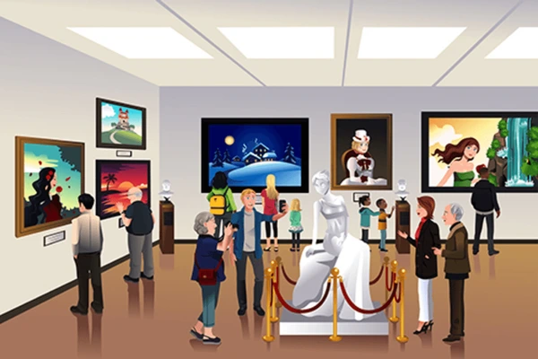
INTRODUCTION
3
Our project focuses on developing an Art Museum and Showroom Database Management System. This system aims to streamline the management of art galleries by efficiently organizing and storing information related to artists, artworks, exhibitions, and customers. By centralizing data management, our system enhances the efficiency of gallery operations, simplifies order management
ART MUSEUM AND SHOWROOM MANAGEMENT SYSTEM

Slide 5
4
PROBLEM STATEMENT
First Problem
We seek to provide gallery administrators with a cohesive platform for managing gallery operations, improving customer satisfaction, and fostering a more organized and efficient art gallery environment.
Art galleries often struggle with manual and disjointed data management processes, leading to inefficiencies in organizing exhibitions.
Second Problem
Existing methods of data management in art galleries lack cohesion and often result in errors.

Slide 6
5
OBJECTIVES
Objective 1
Objective 1I
To design and implement a robust Art Museum and Showroom Database Management System that centralizes the management of artist, artwork, exhibition, and customer data to streamline gallery operations.
To enhance the efficiency and organization of art galleries by providing gallery administrators with a comprehensive platform for managing exhibitions, tracking artwork sales, and maintaining customer records

Slide 7
6
METHODOLOGY
Database Design
Database Creation
We start by designing the database schema using an Entity-Relationship (ER) model. This involves identifying the entities (such as artists, artworks, exhibitions, and customers) and their relationships, attributes, and constraints.
Once the database design is finalized, we create the database tables using Structured Query Language (SQL). Each table corresponds to an entity in the ER model, and we define the structure, data types, and constraints for each table.

Slide 8
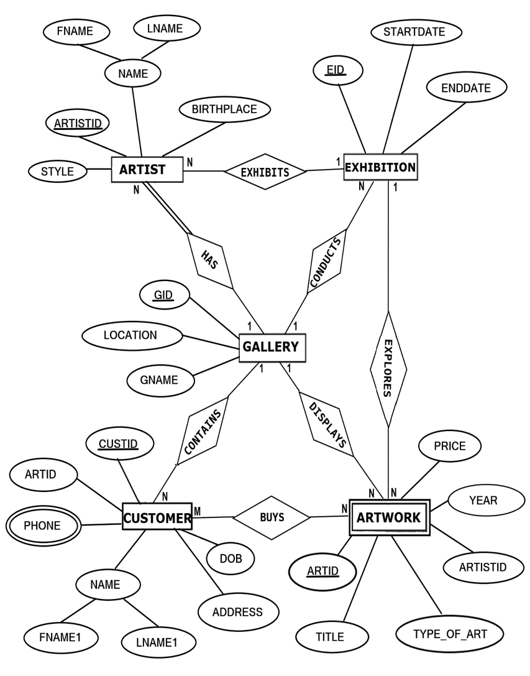

Slide 9
7
IMPLEMENTATION
Phase 1
Phase 3
Design the database schema using an Entity-Relationship (ER) model.
Identify entities such as artists, artworks and customers.
Populate the database tables with sample data using SQL INSERT.
Include a variety of data to simulate real-world scenarios.
Phase 2
Phase 4
Create database tables based on the ER model using SQL.
Define the structure, data types, and constraints for each table.
Implement queries for various operations, such as displaying artworks by artist, updating customer information, or deleting records.

Slide 10
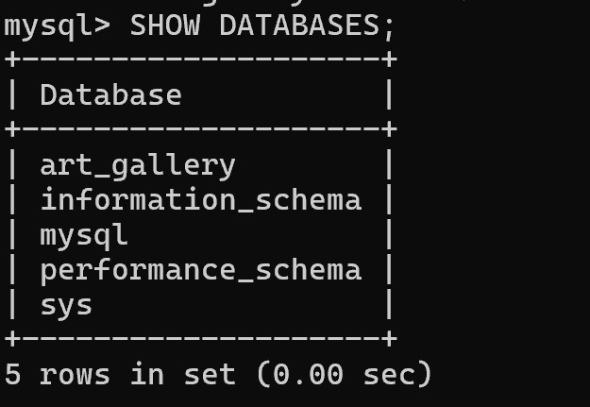
8

Slide 11
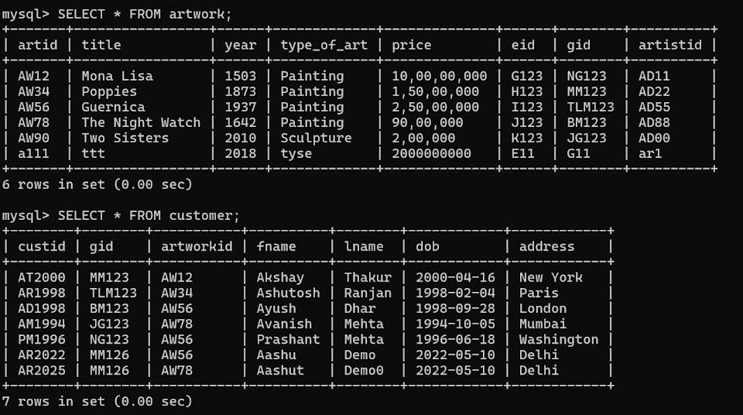
9

Slide 12
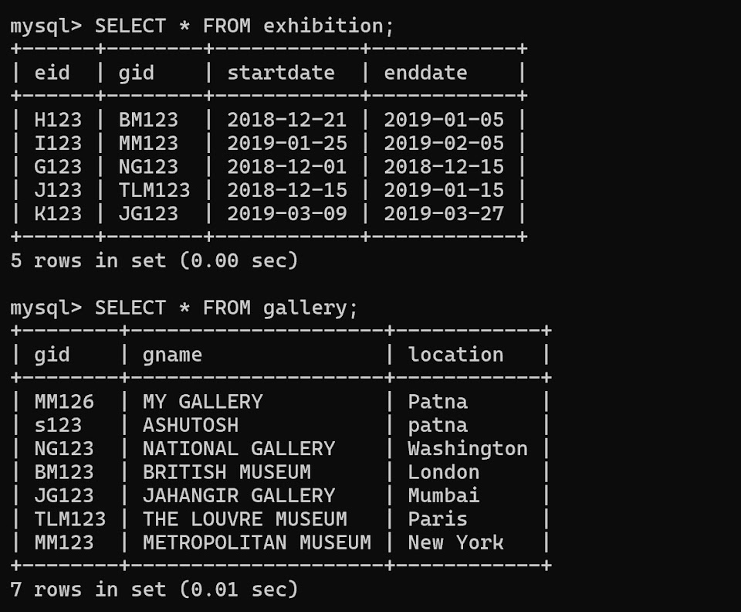
10

Slide 13
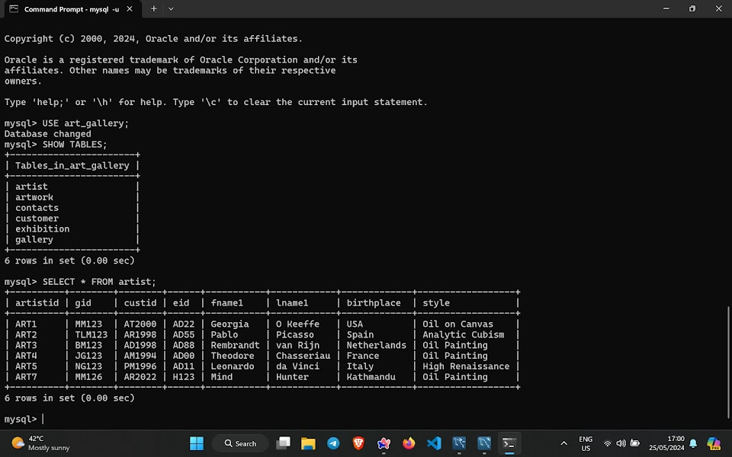
11

Slide 14
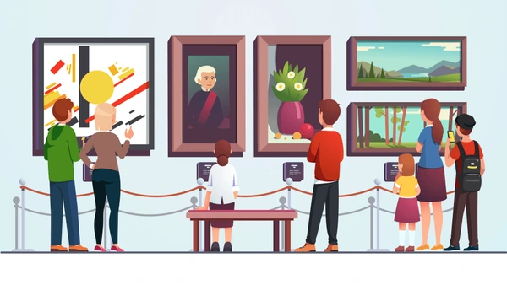
12
﻿RESULT
The Art Museum and Showroom Database Management System has streamlined gallery operations, enhancing data organization and facilitating smoother management of exhibitions, artworks, and customer interactions.

Slide 15
THANK YOU
Efforts By :
Vansh Dhawan (2K22/CO/489)
Yash Jain (2K22/CO/511)

Slide 16
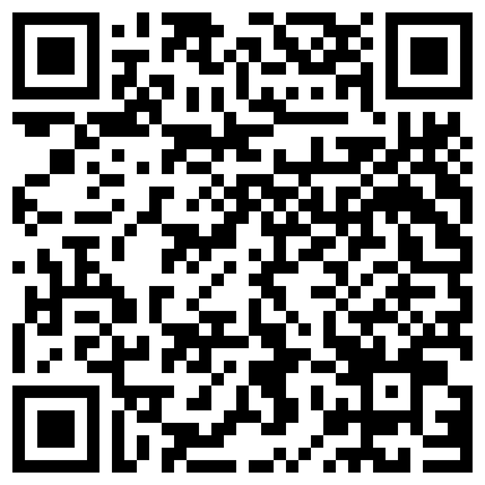
SCAN TO VIEW THE ENTIRE PROJECT:

